Slide 1
Database analysis and modelling
INF08104: Database Systems
Brian Davison, 2014/15

Slide 2
Agenda
Describing schemas
Business rules
Database lifecycle
Conceptual design
Logical design
Physical design

Slide 3
Communication and coordination
Documentation
Checking the results of analysis
Establishing a common understanding
Passing information between roles/teams
Process
Provides a means of separating different types of activity
Provides a number of opportunities for verification

Slide 4
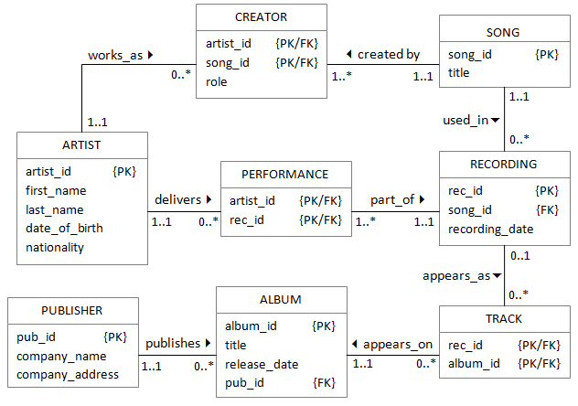
Describing schemas

Slide 5
Describing schemas
artist(artist_id, first_name, last_name, data_of_birth, nationality)
creator(artist_id, song_id, role)
song(song_id, title)
performance(artist_id, rec_id)
recording(rec_id, song_id, recording_date)
track(rec_id, album_id)
album(album_id, title, release_date, pub_id)
publisher(pub_id, company_name, company_address)

Slide 6
Business rules
Structural
One artist may create many songs, and one song must be created by one or more artists
One artist may perform on many recordings, and one recording must have one or more performers
One album is made up of many track recordings, and one recording may be used on many albums
One publisher publishes many albums, and one album is published by one publisher
Data
An artist can contribute to the creation of a song as lyricist or composer

Slide 7
A special component
No other system components use the same conceptual framework, and therefore the database needs specific attention.
The database is a logically fundamental component on which everything else depends
It is difficult to test a partially constructed database

Slide 8
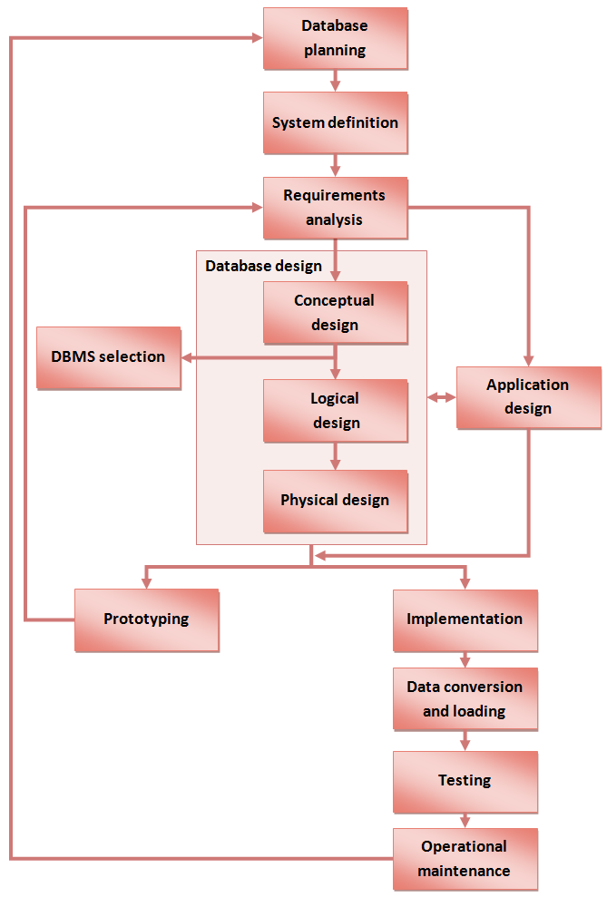
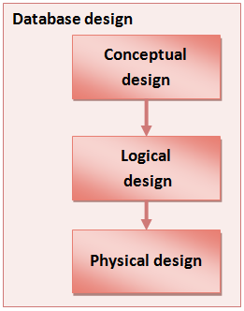
Database lifecycle

Slide 9
Conceptual design (Connolly & Begg)
Identify entity types
Identify relationship types
Identify and associate attributes with entity or relationship types
Determine attribute domains
Determine candidate, primary and alternate key attributes
Consider using enhanced modelling concepts
Check model for redundancy
Validate conceptual model against user transactions
Review conceptual data model with user

Slide 10
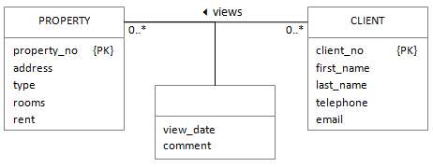
Conceptual design results
Partial ER diagram
Captures the user's view of the world

Slide 11
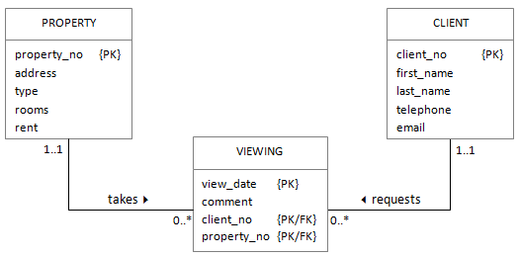
Logical design
Derive relations for the logical model
Validate relations using normalisation (this is covered in week 6)
Validate relations against user transactions
Check integrity constraints
Review logical model with the user

Slide 12
Data dictionary
Table name | Column name | Contents | Type | Format | Domain | Mand | Key | Reference
PROPERTY | property_no | Unique id | Integer | 09999 | 1-99999 | Y | PK
 | address | Postal address | Text | Xxxxx |  | Y
 | type | Type code | Character | X | F, H | Y
 | rooms | Number of rooms | Integer | 09 | 1-16 | Y
 | rent | Monthly rent | Money | £0999 | 100-2000 | Y
CLIENT | client_no | Unique id | Integer | 09999 | 1-99999 | Y | PK
 | first_name | First name | Text | Xxxxx
 | last_name | Last name | Text | Xxxxx |  | Y
 | telephone | Telephone number | Text |  | [0-9],+,(,), space | Y
 | email | email address | Text
VIEWING | view_date | Date of viewing | Date | dd/mm/yyyy |  | Y | PK
 | comment | Notes | Text
 | client_no | Client reference | Integer | 09999 | 1-99999 | Y | PK/FK | CLIENT
 | property_no | Property reference | Integer | 09999 | 1-99999 | Y | PK/FK | PROPERTY

Slide 13
Physical design
Independent of all physical considerations
Mapped to a relational structure
Implemented on a specific physical device

Slide 14
Physical design tasks
Selecting datatype definitions for each column
Designing constraints on the data
Designing user views (covered in week 8)
Designing indexes to improve query times (covered in week 8)
Distributing database files across one or more disks
Determining storage space requirements
Calculating how the data is likely to grow over time
Designing security mechanisms (covered in week 11)
Platform-specific performance tuning

Slide 15
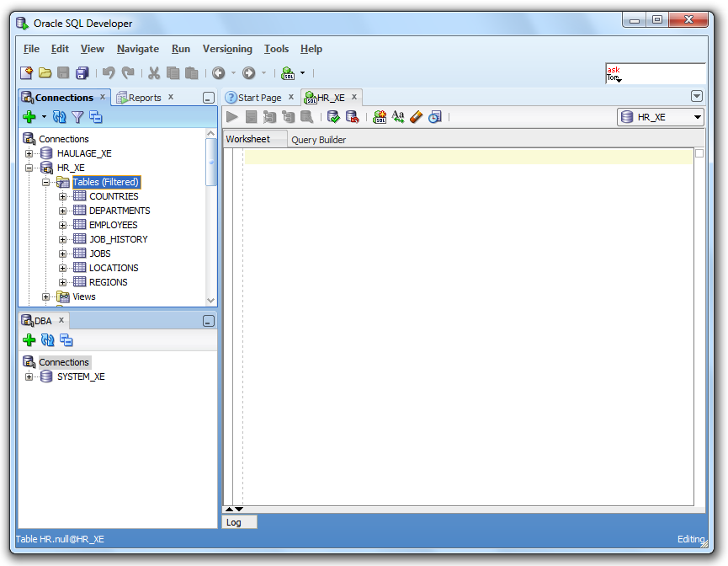
Notes:
Today, try to complete tutorials 0 and 1
If you find them easy, go on to 1b
Use the lecture notes to help you, and ask for help if you get stuck

